Slide 1

Versions
Current Version: 0.10.1.1
Version Used: 0.9.0

Slide 2
Agenda
Topics
Introduction - Messaging System
What is Kafka? Why Kafka?
Key Terminologies
Architecture
Assignment
Creation of Topic, producer and Consumer
Test Yourself
Topics
Reference Links

Slide 3































Big Data Ecosystem
Streaming Engines
Data Store
Data Processing
Peripherals
Data Services
Distributions
Cloud Exposure
3

Slide 4





Introduction - Messaging System
A Messaging System is responsible for transferring data from one application to another, so the applications can focus on data, but not worry about how to share it.
Types of messaging patterns
Point to Point
Publish-Subscribe
Receiver
Sender
Receiver
Sender
Receiver
Message Queue
Message Queue
Receiver

Slide 5
What is Kafka? Why Kafka?
Distributed publish-subscribe system.
Handle a high volume of data (real-time data feeds).
Fault tolerant
Ability to handle a large number of consumers.
Very fast, performs 2 million writes/sec.
Uses “distributed commit log”, which means messages persists on disk as fast as possible, hence it is durable.

Slide 6
Key Terminologies
A category or feed name to which records are published
Topics may have many partitions, so it can handle an arbitrary amount of data
Each partitioned message has a unique sequence id called as “offset”
Publish data to the topics. Producers send data to brokers
Responsible for maintaining the published data. Appends data published by the producer to a partition
Read data from brokers. Consumers subscribes to one/more topics and consume published messages by pulling data from the brokers
Topic
Partition
Partition offset
Producer
Broker
Consumer

Slide 7
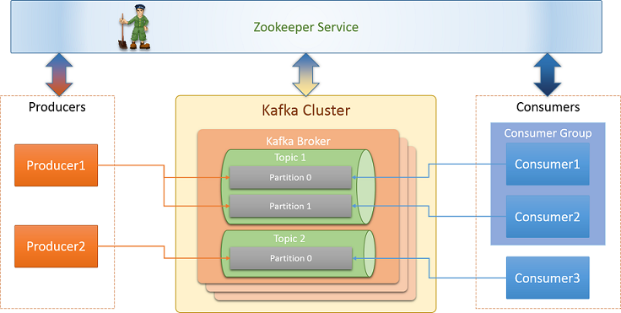
Architecture
Broker

Slide 8
Creation of Topic, Producer and Consumer
Topic
Producer
Consumer

Slide 9
Reference Links
Kafka Installation
https://www.digitalocean.com/community/tutorials/how-to-install-apache-kafka-on-ubuntu-14-04
Click to view the document for installation
Getting Started
https://kafka.apache.org/intro

Slide 10


Test Yourself
Answer the following questions:
Is zookeeper a must?
How many topics can be created?
Yes, zookeeper is used to track broker, topic, partition and replicas
How many partitions can be created?
Any number of partitions can be created
Any number of topics can be created

Slide 11
Assignment
Installation of Kafka
Create a topic “Synapt”
Create producer that should publish messages as – Synapt Connect, Synapt Middleware, Synapt Data Lake , Synapt Service Manager
Create a consumer that should consume those messages published by the producer
Write a sample kafka producer program
1
2
3
4
5

